Slide 1


Intermediate Code Generation By Prof. Londhe D. N Assistant Professor GIT, Lavel
GHARDA FOUNDATION’S
GHARDA INSTITUTE OF TECHNOLOGY, LAVEL
Department of Computer Engineering

Slide 2
Introduction
In the analysis-synthesis model of a compiler, the front end analyzes a source program and creates an intermediate representation, from which the back end generates target code.
details of the source language are confined to the front end, and details of the target machine to the back end.

Slide 3
Compiler Architecture
Intermediate Code
Scanner
(lexical
analysis)
tokens
Parser
(syntax
analysis)
Syntactic
structure
Semantic
Analysis
(IC generator)
Code
Generator
Source
language
Target
language
Intermediate Code
Intermediate Code
Code
Optimizer
Symbol
Table

Slide 4
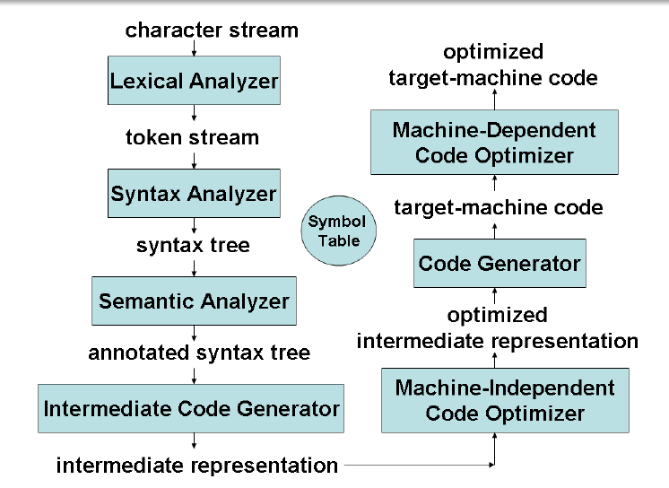

Slide 5
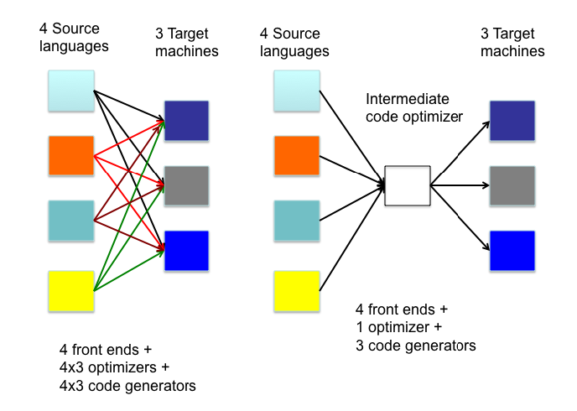
Why Intermediate Code?

Slide 6
While generating machine code directly from source code is possible, it entails two problems
With m languages and n target machines, we need to write m front ends, m n optimizers, and m n code generators
The code optimizer which is one of the largest and very-difficult-to-write components of a compiler, cannot be reused

Slide 7
By converting source code to an intermediate code, a machine-independent code optimizer may be written
This means just m front ends, n code generators and 1 optimizer

Slide 8
Syntax Directed methods can be used to translate into an intermediate form for various programming language construct such as declarations, assignments and flow of control statements.

Slide 9

A compiler might use a sequence of intermediate representations

Slide 10
Intermediate Languages
Syntax Tree (High –Level)/DAG
Postfix notation
Three Address Code (Low-Level)

Slide 11
Syntax Tree
A syntax tree depicts the natural hierarchical structure of a source program.
DAG (Directed Acyclic Graph)- DAG is a syntax tree but in a more compact way because common sub expressions are identified.

Slide 12
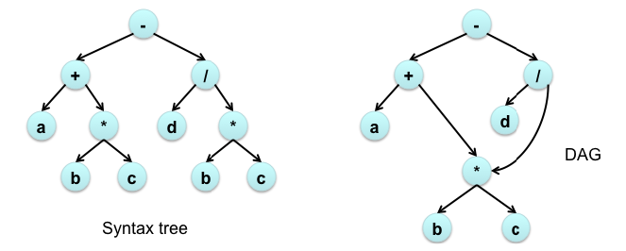
Ex. a + b * c – d / ( b * c )

Slide 13
STs and DAGs: a := b *-c + b*-c
:=
:=
a
+
a
+
*
*
*
b
- (uni)
b
- (uni)
b
- (uni)
c
c
c

Slide 14
Postfix Notation
Postfix notation is a linearized representation of a syntax tree.
Postfix notation = Left right root
Ex. abc*+dbc*/-

Slide 15
Three Address Code
Three-address code is a sequence of statements of the general form
x = y op z
Where,
x, y and z are names, constants or compiler generated temporaries.
op stands for any operator

Slide 16
Another way to represent tree in linearized form is Three-address-code Notation.
In Three Address Code method, internal nodes are given names. It is a low level Intermediate code representation.
The reason for the term ‘Three address code’ is that each statement usually contains three addresses, two for the operands and one for the result.

Slide 17
Example
Example: The three-address code for a+b*c-d/(b*c) is below
t1 = b*c
t2 = a+t1
t3 = b*c
t4 = d/t3
t5 = t2-t4

Slide 18
Implementations of 3-Address Code
Quadruples- A quadruple is a record structure with four fields, which we call op, arg1, arg2 and result.
The op field contains an internal code for the operator.
Example . x = y op z
where arg1 = y , arg2 =z , result =x op =op

Slide 19
Example x = -y or x = y do not use arg2
Operators like param use neither arg2 not result.
Conditional and unconditional jumps put the target label in result.
The contents of fields arg1, arg2 and result are normally pointers to the symbol-table entries for the names represented by these fields.
If so, temporary names must be entered into the symbol table as they are created.

Slide 20
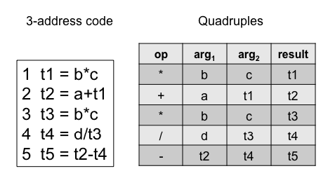
Example a + b * c – d / ( b * c )

Slide 21
Triples
Three address statements can be represented by records with only three fields: op, arg1 and arg2.
The fields arg1 and arg2 are either pointer to the symbol table or pointers into the triple structure .
Parenthesized numbers represent pointers into the triple structure, while symbol-table pointers are represented by the names themselves.

Slide 22
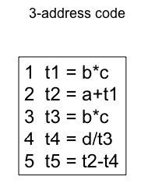
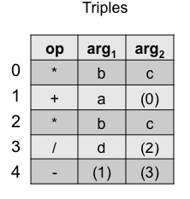
Example a + b * c – d / ( b * c )

Slide 23
A ternary operation like x[ i] = y require two entries in the triple structure, while x = y[ i] is naturally represented as two operations.
(a) x[i] = y (b) x = y[i]
 | op | arg1 | arg2
(0) | [ ] = | x | i
(1) | Assign | Y | (0)
 | op | arg1 | arg2
(0) | = [ ] | y | I
(1) | assign | (0) | X

Slide 24
Indirect triples
In indirect triples we are going to list the pointers to the triples in an array.
Example a + b * c – d / ( b * c )
Triples Indirect Triples
 | op | arg1 | arg2
(15) | * | b | c
(16) | + | s | (15)
(17) | * | b | c
(18) | / | d | (17)
(19) | - | (16) | (18)
 | Statement
(0) | (15)
(1) | (16)
(2) | (17)
(3) | (18)
(4) | (19)

Slide 25
Comparison of Representation
When target code is produced, each name , temporary or programmed-defined will be assigned some run time memory location. This location is there in memory.
Using the quadruple notation, a three-address statement defining or using a temporary can immediately access the location for that temporary via the symbol table.

Slide 26
In an optimization phase, where statements are often moved around.
In quadruple notation, if we move statement computing x, the statements using x require no change.
However, in the triples notation if we move statement computing x, then we need to change all the statements that are using x (references need to be changed)

Slide 27
Conclusion: triple notation is difficult to use in optimizing compiler.
Indirect triples present no such problem. A statement can be moved by reordering the statement list

Slide 28
Types of Three-Address statements
Assignment instructions:
a = b biop c,
a = uop b,
a = b (copy)
where
biop is any binary arithmetic, logical, or relational operator
uop is any unary arithmetic (-, shift, conversion) or logical operator (~)
Conversion operators are useful for converting integers to floating point numbers, etc.

Slide 29
Jump instructions:
goto L (unconditional jump to L),
if t goto L (it t is true then jump to L),
if a relop b goto L (jump to L if a relop b is true),
where
L is the label of the next three-address instruction to be executed
t is a Boolean variable
a and b are either variables or constants

Slide 30
Functions:
func begin <name> (beginning of the function),
func end (end of a function),
param p (place a value parameter p on stack),
refparam p (place a reference parameter p on stack),
call f, n (call a function f with n parameters),
return (return from a function),
return a (return from a function with a value a)

Slide 31
Indexed copy instructions:
a = b[i](a is set to contents(contents(b)+contents(i)),
where b is (usually) the base address of an array
a[i] = b (ith location of array a is set to b)

Slide 32
Pointer assignments:
a = &b (a is set to the address of b, i.e., a points to b)
*a = b (contents(contents(a)) is set to contents(b))
a = *b (a is set to contents(contents(b)))

Slide 33
Boolean Expression
Methods of Translating Boolean Expressions
Numerical Representation
We denote 1 as a true and 0 as a false, then we evaluate expression completely, from left to right in a manner similar to arithmetic expressions.
For example
a or b and not c
Grammar to generate Boolean expression
E->E or E | E and E| not E | (E) | id relop id |true | False

Slide 34
Three address code is
t1 = not c
t2 = b and t1
t3 = a or t2
Example 2.
a<b which is equivalent to the conditional statement
if a<b then 1 else 0

Slide 35
Three address code is as follow
100: if a<b goto 103
101: t = 0
102: goto 104
103: T = 1
104:

Slide 36
Case statements
Switch statement syntax
switch E
begin
case V1 : S1
case V2: S2
. . .
case Vn-1: Sn-1
default: Sn
end

Slide 37
Three address code for switch statement
Code to evaluate E into t
goto test
L1: code for S1
goto next
L2: code for S2
goto next
……..
Ln-1: code for Sn-1
goto next
Ln: code for Sn
goto next
Test: if t = V1 goto L1
if t = V2 goto L2
……
if t = Vn-1 goto Ln-1
goto Ln
Next:

Slide 38
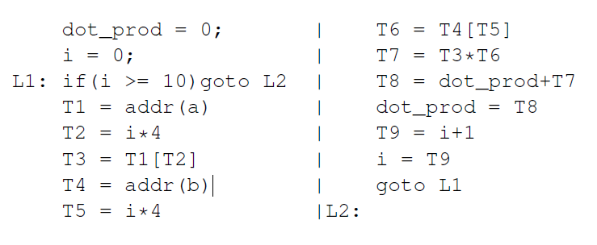
Intermediate Code - Example 1
C-Program
int a[10], b[10], dot_prod, i;
dot_prod = 0;
for (i=0; i<10; i++) dot_prod += a[i]*b[i];
Intermediate code

Slide 39
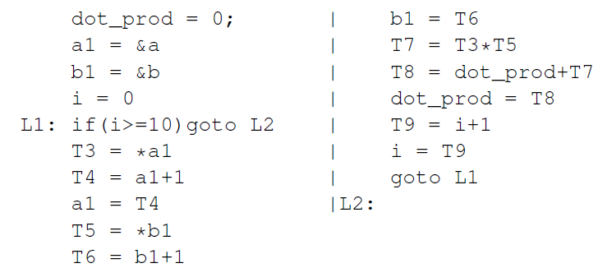
Intermediate Code - Example 2
C-Program
int a[10], b[10], dot_prod, i; int* a1; int* b1;
dot_prod = 0; a1 = a; b1 = b;
for (i=0; i<10; i++) dot_prod += *a1++ * *b1++;
Intermediate code

Slide 40
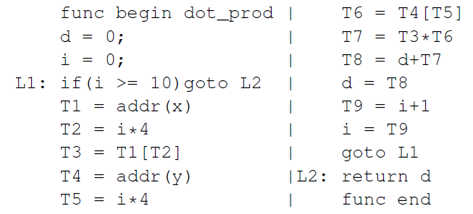
Intermediate Code - Example 3
C-Program (function)
int dot_prod(int x[], int y[]){
int d, i; d = 0;
for (i=0; i<10; i++) d += x[i]*y[i];
return d;
}

Slide 41
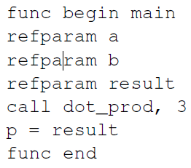
Intermediate Code - Example 3 (contd.)
C-Program (main)
main(){
int p; int a[10], b[10];
p = dot_prod(a,b);
}
Intermediate code

Slide 42
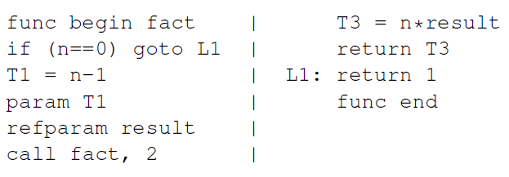
Intermediate Code - Example 4
C-Program (function)
int fact(int n){
if (n==0) return 1;
else return (n*fact(n-1));
}
Intermediate code

Slide 43
Code Templates for If-Then-Else Statement
Assumption: No short-circuit evaluation for E (i.e., no jumps within the intermediate code for E)
If (E) S1 else S2
code for E (result in T)
if T 0 goto L1 /* if T is false, jump to else part */
code for S1 /* all exits from within S1 also jump to L2 */
goto L2 /* jump to exit */
L1: code for S2 /* all exits from within S2 also jump to L2 */
L2: /* exit */
If (E) S
code for E (result in T)
If T 0 goto L1 /* if T is false, jump to exit */
code for S /* all exits from within S also jump to L1 */
L1: /* exit */

Slide 44
Code Template for While-do Statement
Assumption: No short-circuit evaluation for E (i.e., no jumps within the intermediate code for E)
while (E) do S
L1: code for E (result in T)
if T 0 goto L2 /* if T is false, jump to exit */
code for S /* all exits from within S also jump to L1 */
goto L1 /* loop back */
L2: /* exit */

Slide 45
Translations for If-Then-Else Statement
Let us see the code generated for the following code fragment.
Ai are all assignments, and Ei are all expressions
if (E1) { if (E2) A1; else A2; }else A3; A4;
—————————————————-
1 code for E1 /* result in T1 */
10 if (T1 <= 0), goto L1 (61)
/* if T1 is false jump to else part */
11 code for E2 /* result in T2 */
35 if (T2 <= 0), goto L2 (43)
/* if T2 is false jump to else part */
36 code for A1
42 goto L3 (82)
43 L2: code for A2
60 goto L3 (82)
61 L1: code for A3
82 L3: code for A4

Slide 46
Translations for while-do Statement
Code fragment:
while (E1) do {if (E2) then A1; else A2;} A3;
1 L1: code for E1 /* result in T1 */
15 if (T1 <= 0), goto L2 (79)
/* if T1 is false jump to loop exit */
16 code for E2 /* result in T2 */
30 if (T2 <= 0), goto L3 (55)
/* if T2 is false jump to else part */
31 code for A1
54 goto L1 (1)/* loop back */
55 L3: code for A2
78 goto L1 (1)/* loop back */
79 L2: code for A3

Slide 47
Control-Flow Realization of Boolean Expressions
if ((a+b < c+d) || ((e==f) && (g > h-k))) A1; else A2; A3;
100: T1 = a+b
101: T2 = c+d
103: if T1 < T2 goto L1
104: goto L2
105: L2: if e==f goto L3
106: goto L4
107: L3: T3 = h-k
108: if g > T3 goto L5
109: goto L6
110: L1:L5: code for A1
111: goto L7
112: L4:L6: code for A2
113: L7: code for A3

Slide 48
Thank you

